Slide 1
CPU Architecture
Presentation By:
Anthony Cerritelli, Bryan Bigelow, Robert Rotaru

Slide 2
Introduction
The CPU is one of the largest heat generators in a computer.
Requires highly purified silicon, the material it’s built on, that is a scarce natural resource.
Acts as the main instruction center of the device.

Slide 3
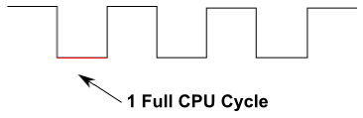
Architecture
Single-Cycle Datapath – Instructions you give to the processor are determined on a clock cycle.
Negative Edge – Instructions are processed on the “bottom”, or 0, of the clock cycle.
16-Bit Architecture - 0000 0000 0000 0000 would be a 16-bit input.

Slide 4
Architecture (Part 2)
Broken into five activity phases:
IF (Instruction Fetch) – Provides the current program location (program counter) and loads the instruction.
ID (Instruction Decode) – Retrieves or writes memory to a “register”, a piece of memory dedicated to the CPU.
EX (Execute) – Mostly contains the ALU (Algorithmic Logic Unit) and handles most of the logic or math of the unit.
MEM (Memory Access) – Accesses the memory of the computer for storage or retrieval
WB (Write Back) – Writes value calculated in EX or retrieved from MEM into a register.

Slide 5
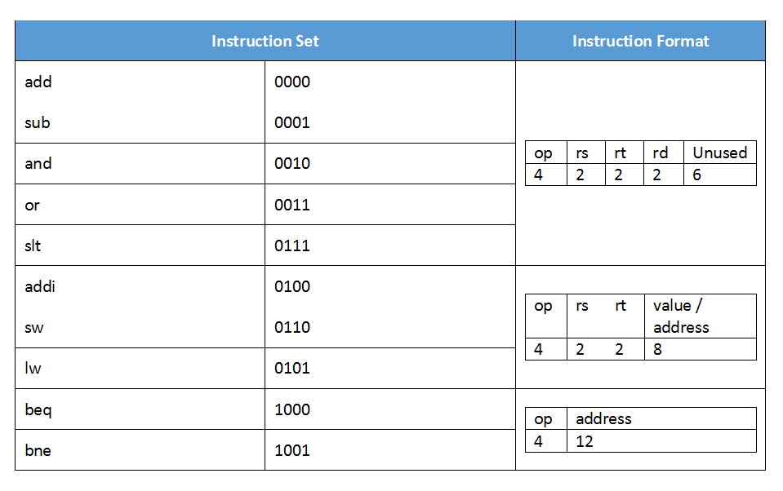
Instructions
Instructions are
assigned to
4-bit numbers
Three types:
R-type (Register)
I-type (Immediate)
J-type (Jump)

Slide 6
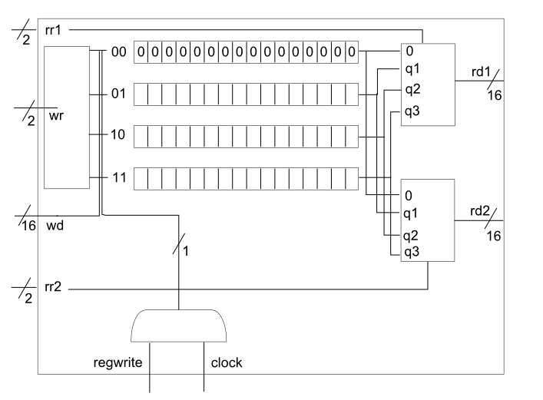
Components (Registers)
This CPU has 4 registers identified
by 2-bits: 00, 01, 10, 11 for
$0, $1, $2, $3.
$0 is read-only for the value 0.

Slide 7
Components (ALU)
Workhorse of the CPU
Strings together 16 separate 1-bit ALU’s to handle 16-bit data
Requires a unique significant bit ALU when chaining

Slide 8
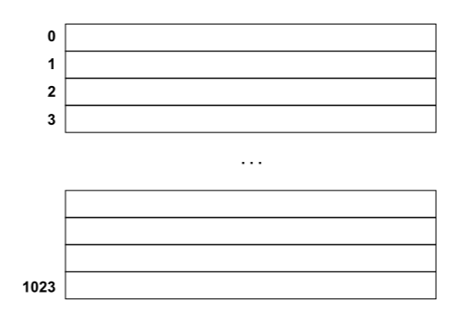
Components (Data Memory)
16-bit storage locations
Internally stored as an array
Can store up to 1024
pieces of data

Slide 9
Components (Pipelines)
Monitors the CPU during each cycle
Stores the results of each cycle to reduce hazards (called forwarding)
Makes for a more efficient process

Slide 10
Execution
lw $1, 0($0) lw $2, 2($0) add $2, $2, $1 addi $1, $1, 1 slt $3, $1, $2 beq $3, $0, 4 sw $1, 2($0) sw $2, 0($0) | lw $1, 0($0) lw $2, 2($0) sub $1, $1, $2 bne $1, $0, -5 sw $1, 2($0) beq $1, $0, 4 addi $t1, $0, 1 addi $t1, $0, 1 | addi $t1, $0, 1 addi $t1, $0, 1 lw $2, 2($0) addi $t1, $0, 3 addi $t2, $0, 1 sw $1, 0($0) sw $2, 2($0) j 0

Slide 11
Thank You!

